Slide 1
Software Testing

Slide 2

The Zen of Programming
Thus spake the master: "Any program no matter how small, contains bugs." The novice did not believe the masters words. "What if the program were so small that it performed but a single function?" he asked.
"Such a program would have no meaning," said the master, "but if such a one existed, the operating system would fail eventually, producing a bug."
But the novice was not satisfied. "What if the operating system did not fail?" he asked.
"There is no operating system that does not fail," said the master, "but if such a one existed, the hardware would fail eventually, producing a bug."
The novice was still not satisfied. "What if the hardware did not fail?" he asked.
The master gave a great sigh. "There is no hardware that does not fail," he said, "but if such a one existed the user would want the program to do something different, and this too is a bug.
A program without bugs would be an absurdity, a nonesuch. If there were a program without any bugs the world would cease to exist."

Slide 3
Darbai
Projektas - 4 dalys – 70%
Iki 4-ių komanda (ta pats projektas, ta pati komanda iš Software Engineering)
Pasirenkamas programinės įrangos projektas.
Aprašomos programinės įrangos funkcijos (Use case, featurai).
L1: Kuriamas testavimo planas.
L2: Unit testing – testuojamas programinės įrangos kodas.
L3: Static analysis – analizuojamas programinės įrangos kodas.
L4: Performance testing – našumo/apkrovos/stresinis testavimas.
1 mėn. Atliekamas darbas, sekantį mėn. ginamas/pristatomas.
1 Testas/egzaminas – 30%
15% LD2 gynimo metu.
15% LD4 gynimo metu.
Arba 30% egzamino diena.

Slide 4




Knygos
Software Testing: An ISEB Foundation
Introduction to Software Testing
xUnit Test Patterns: Refactoring Test Code

Slide 5
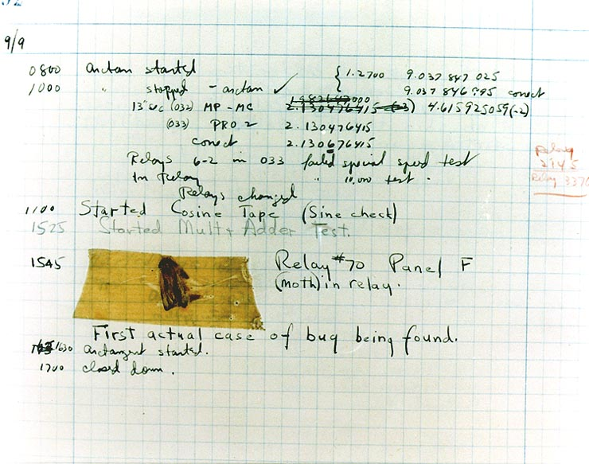
Bug

Slide 6
Bugs a.k.a. …
Defect
Fault
Problem
Error
Incident
Anomaly
Variance
Failure
Inconsistency
Product Anomaly
Product Incidence
Feature
Ur fav name?

Slide 7
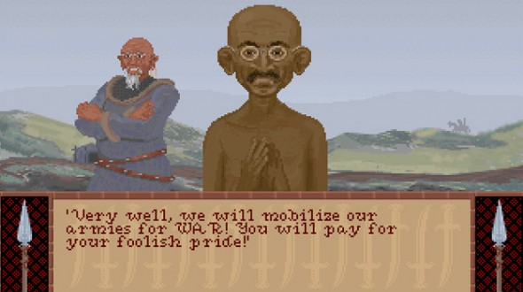
Civilization & Gandhi
What caused Gandhi’s insatiable bloodlust in Civilization
In the earlier Civs, leaders are given a set of attributes that dictate their behavior.
One such attribute is a number scale associated with aggressiveness.
Gandhi was given the lowest number possible, a rating of 1.
However, when a civilization adopted democracy, it granted a civilization -2 to opponent aggression levels.
This sent Gandhi’s rating of 1 into the negative, which swung it back around to 255 — the highest possible rating available, and thus, the infamous warmonger Gandhi was born.

Slide 8
Na ir kas sukuria tuos features?
Programmers...
No s.....

Slide 9
Klaidų šaltiniai
Sistemos reikalavimai:
Neteisingi, nepilnai aprašyti, prieštaraujantys.
Architektūra:
Neteisingi architektūriniai sprendimai.
Įgyvendinimas:
Defektuota elektronika, neteisingas komponentų apjungimas, programavimo klaidos, piktybiškas kodas.
Pagalbinės sistemos:
Prastos programavimo kalbos, klaidingi kompiliatoriai ir debuggeriai, klaidingos kūrimo priemonės.
Nepakankamas testavimas:
Prastas verifikavimas
Klaidos derinimo metu.
Palaikymas ir priežiūra:
Atmestinai atlikti priežiūros ar perdarymo darbai.
Naujų klaidų įtraukimas taisant senas klaidas.
Didėjantis sistemos sudėtingumas.

Slide 10
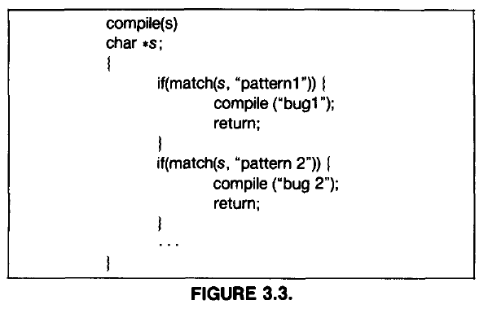
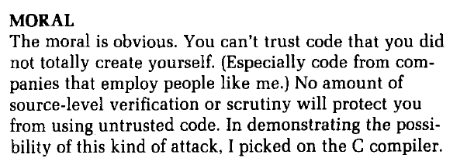
Ken Thompson Hack (1984)
Kaip sugadinti ir ikompiliuoti piktybišką kodą.
Compiler->Compiler->Code.

Slide 11
Pavyzdžiai
Kodėl svarbu testuoti.
Samples (Introuction – 7 slide)
Jūsų pavyzdžiai...
Free money at ATM
Border controll.
POS of PCs...

Slide 12
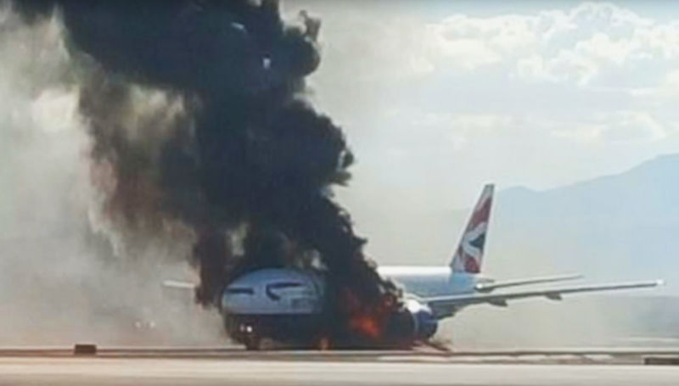
Quality costs – ar verta testuoti?

Slide 13
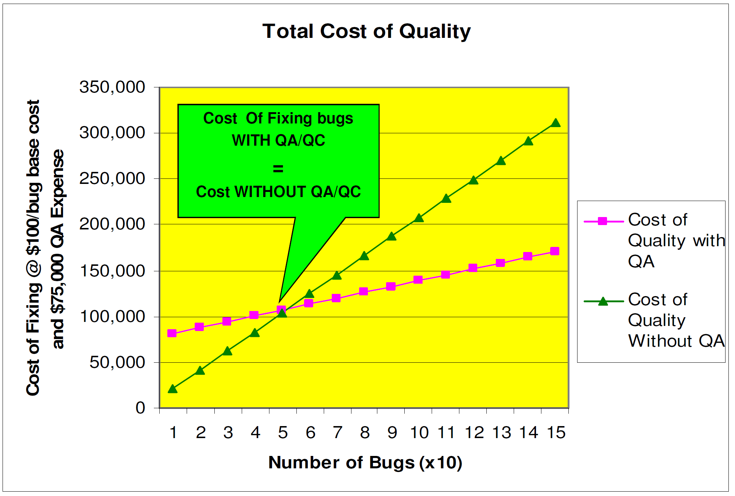
Simple....

Slide 14
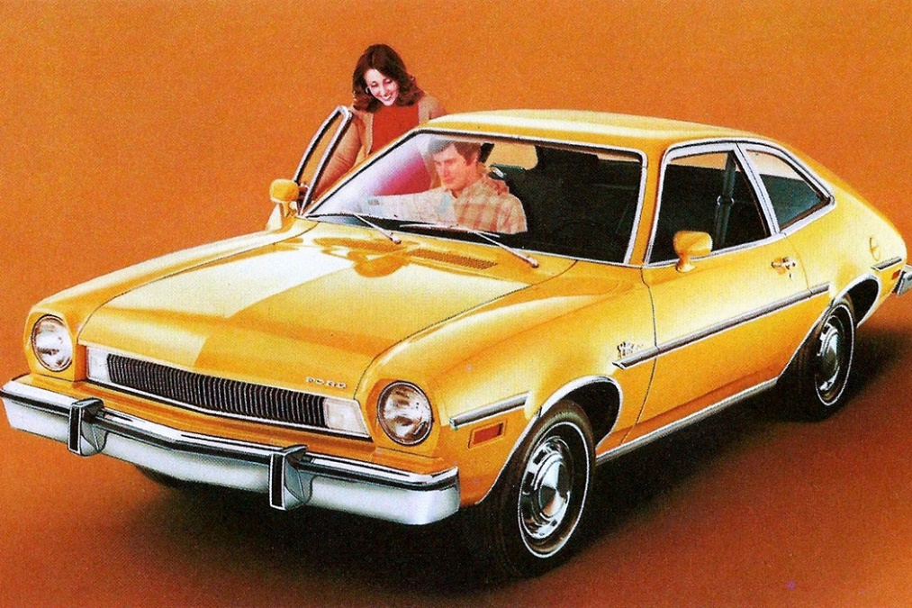
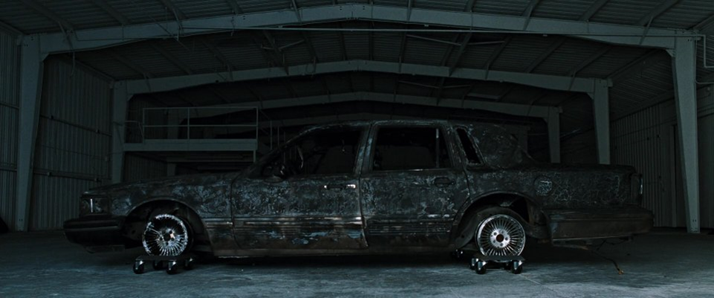
Ford Pinto
"Narrator: On a long enough time line, the survival rate for everyone drops to zero. I was a recall coordinator. My job was to apply the formula. A new car built by my company leaves somewhere travelling at 60 miles per hour, the rear differential locks up, the car crashes and burns with everyone trapped inside. Now, should we initiate a recall? Take the number of vehicles in the field; A, multiply it by the probable rate of failure; B, then multiply the result by the average out-of-court settlement; C. A times B times C...(the film then cuts to him talking a to a fellow passenger on a plane flight) ...equals X. If X is less than a cost of a recall, we don't do one.

Slide 15
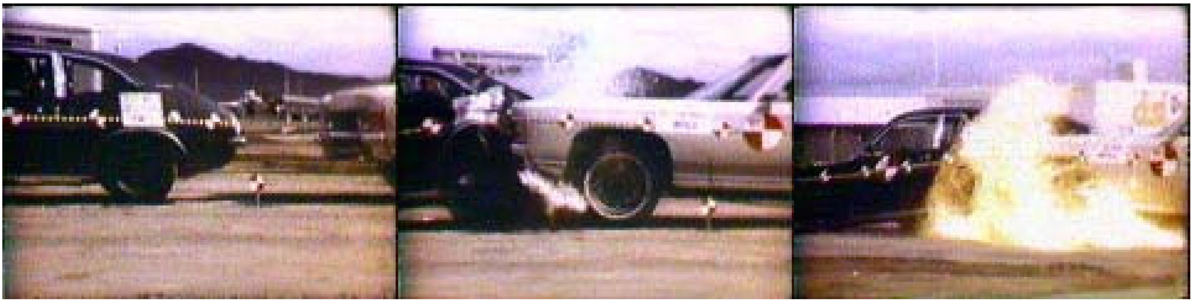
Testavimo rezultatai
Į gala įvažiuoja > 25 MPH: Dega kuro bakas
Į gala įvažiuoja > 40 MPH: Dega kuro bakas + nebeatsidaro durys
https://www.youtube.com/watch?v=rcNeorjXMrE

Slide 16
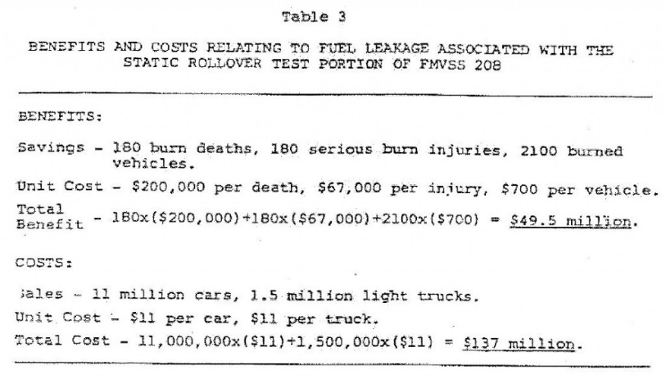
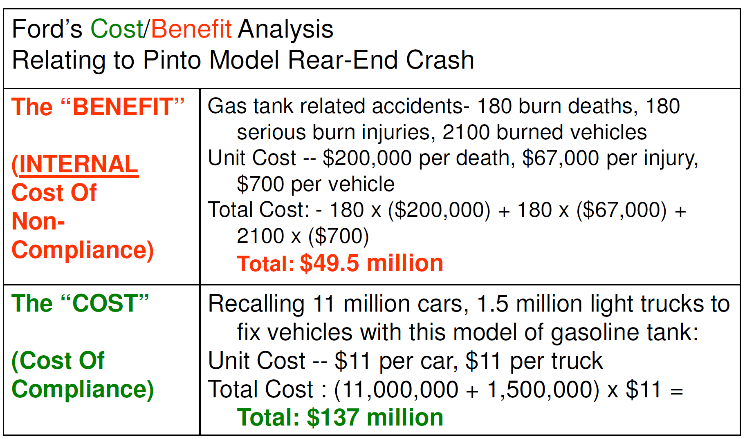
Matematika

Slide 17
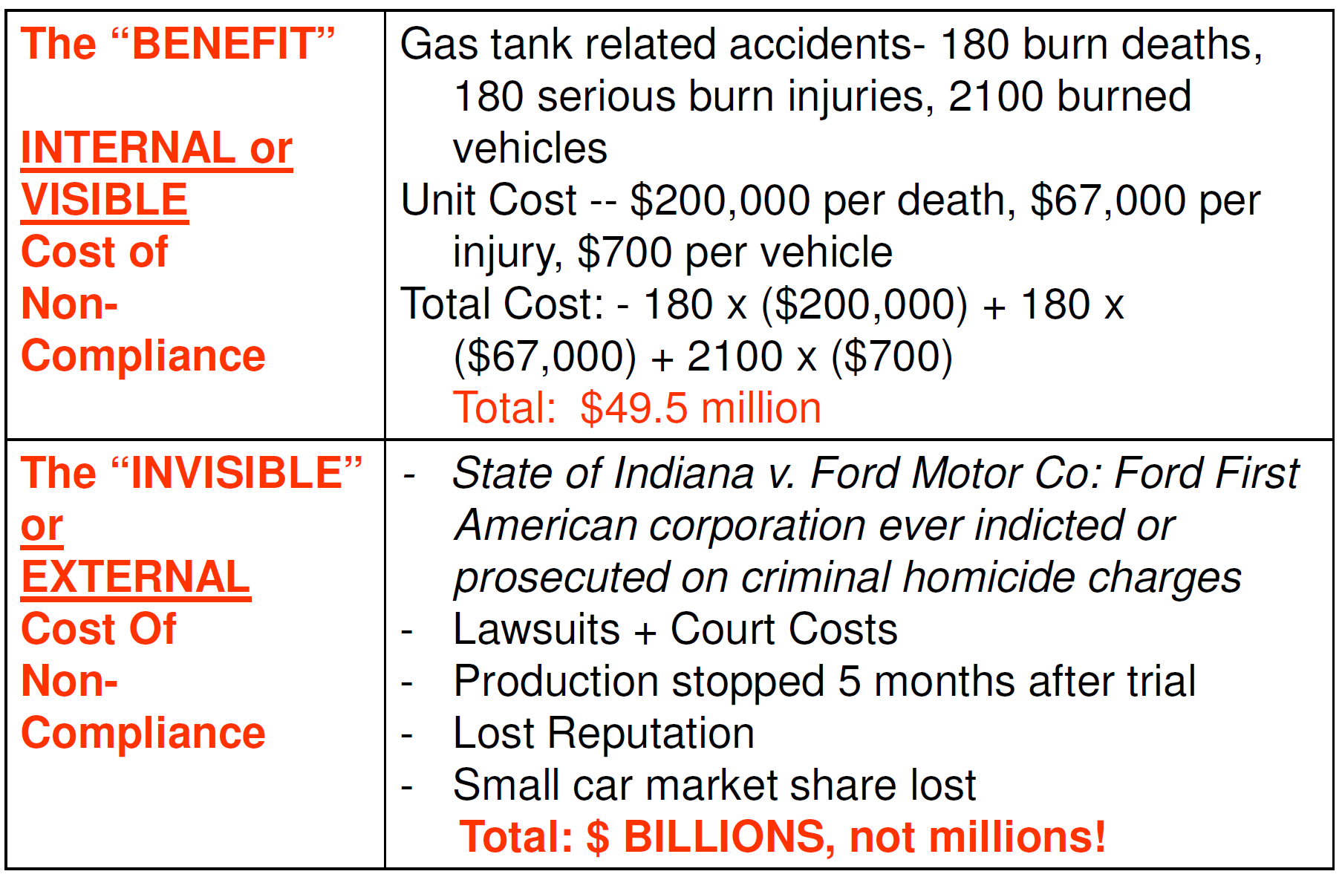
Resultatas

Slide 18
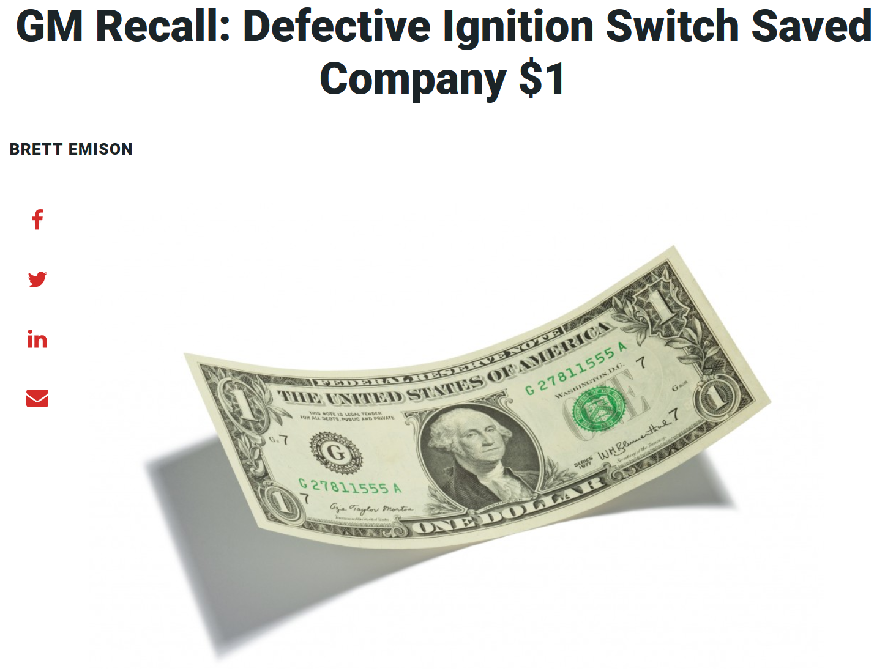
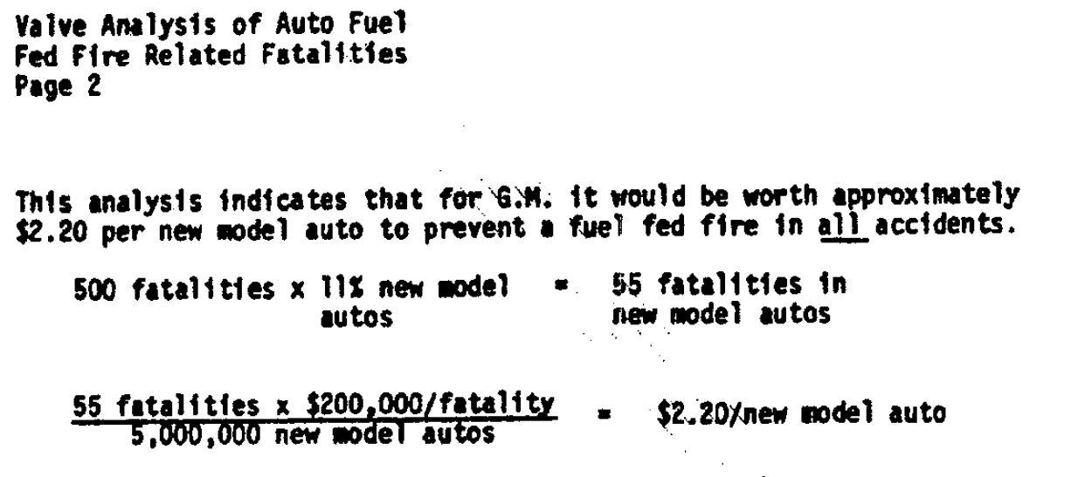
Ir toliau…
https://affiliates.legalexaminer.com/legal/gm-recall-defective-ignition-switch-saved-company-1/

Slide 19
Testavimas
Programinės įrangos tikrinimas siekiant aptikti klaidas.
Niekad nesibaigia.
Neparodo kad nebeliko klaidų.
O gal nereikia testuoti?

Slide 20
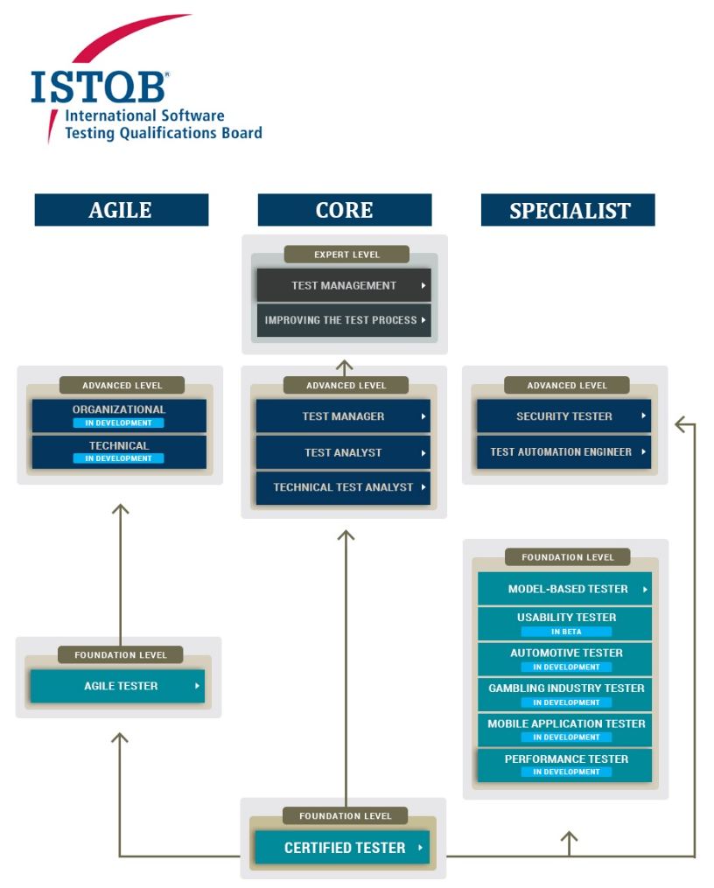
Testuotojo profesija
Kuria testus
Vykdo testus
Valdo testavimą
Planuoja testavimą
Specializacija

Slide 21
Q/A s.v.p.

